Slide 1
February Snow

Slide 2
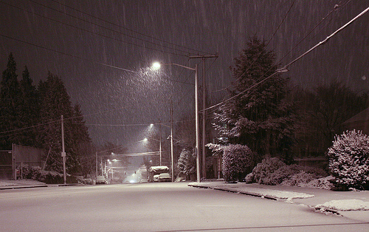
Why are snowstorms rare over Seattle and the western Washington lowlands?
To get snow you need cold and wet.
It is easy to be mild and wet here
Sometimes we are cold and dry
To get cold and wet is very hard…

Slide 3
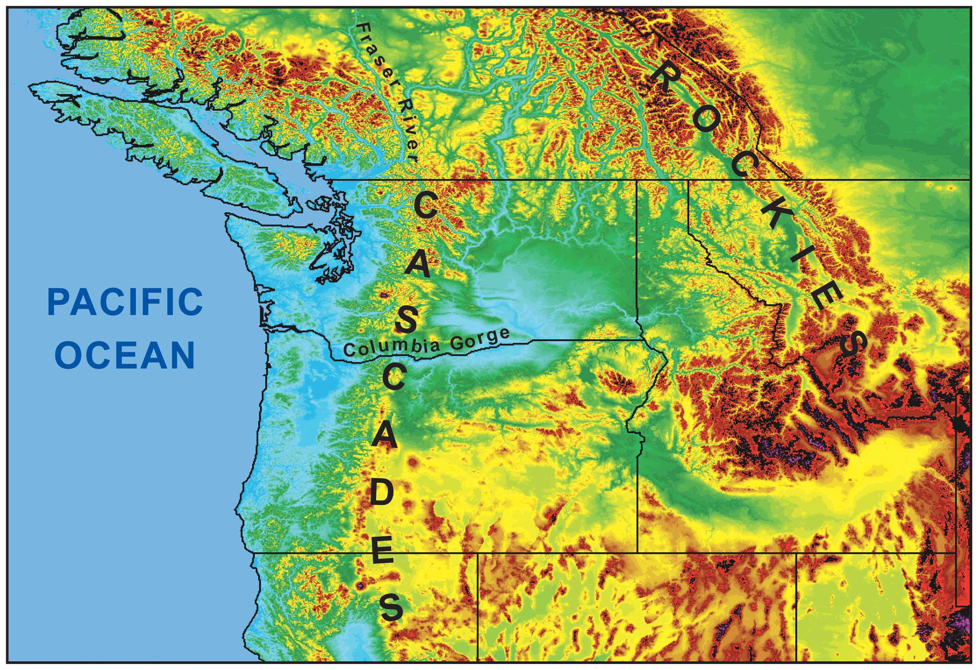
Onshore flow is generally mild and moist
Offshore flow is generally dry and cold
Cold
Air

Slide 4
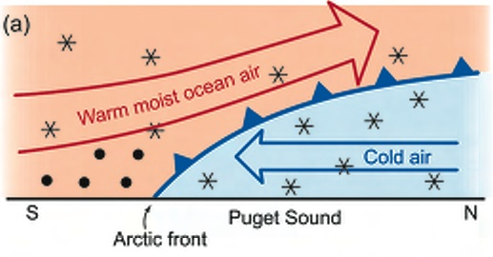
The secret of Northwest snow is usually to bring in cold air from the north and interior (or have it already in place) while moist, cool Pacific air moves in aloft.

Slide 5
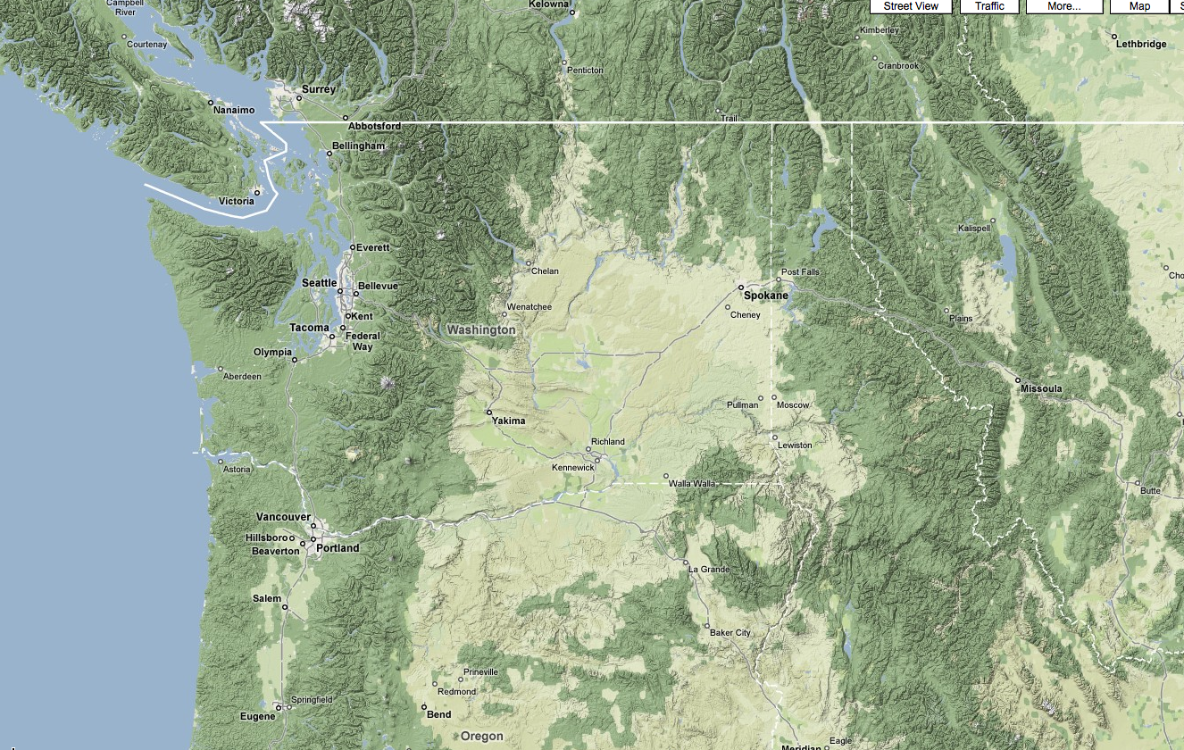
Cold Air
Moisture

Slide 6
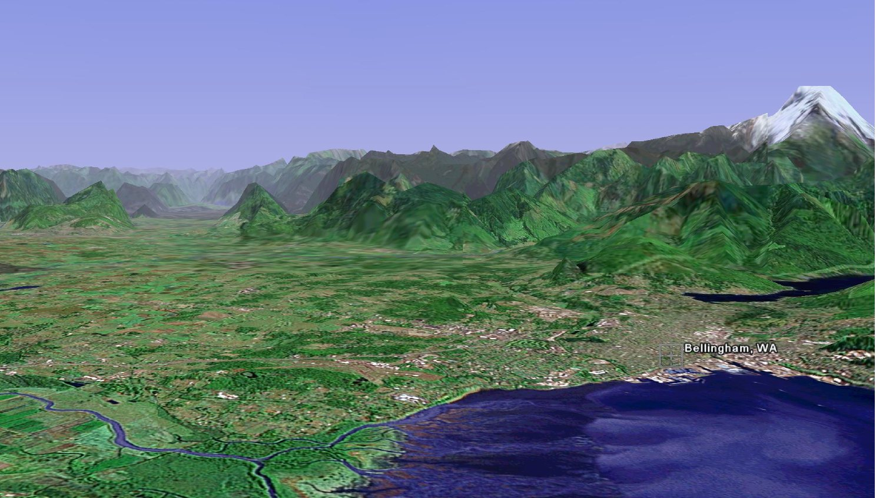
The Fraser River Valley is an important conduit of cold air into western Washington.

Slide 7
Two Main Snow Producers for Western WA
Upper trough moving in from the north, with development of low center over SW WA
Warm advection snow: cold air in place, with approach of moist frontal system

Slide 8
Trough

Slide 9
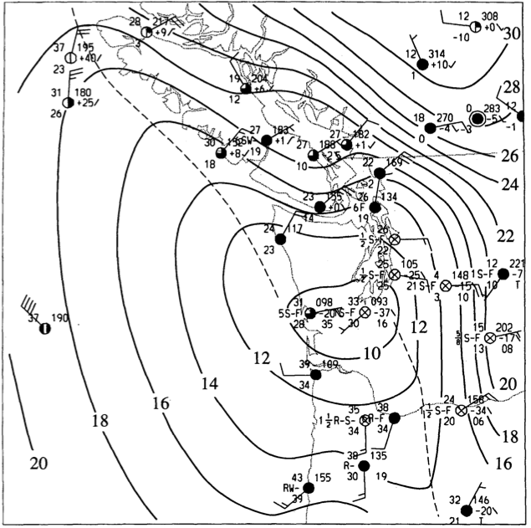

Slide 10
Over-running

Slide 11
Temperatures
NWS heavily uses 1300 meters for 1000-850 hPa thickness

Slide 12
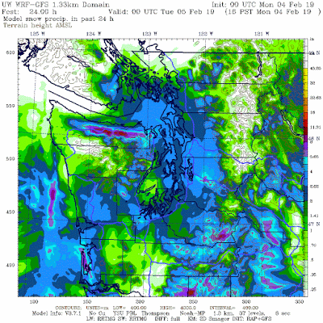
Forecasting Skill
Generally very good….the best we have ever done--but there were issues.
Best when cold air was in place and was sure to be in place.
Models could not hold cold air in for last storm. Classic problem.

Slide 13
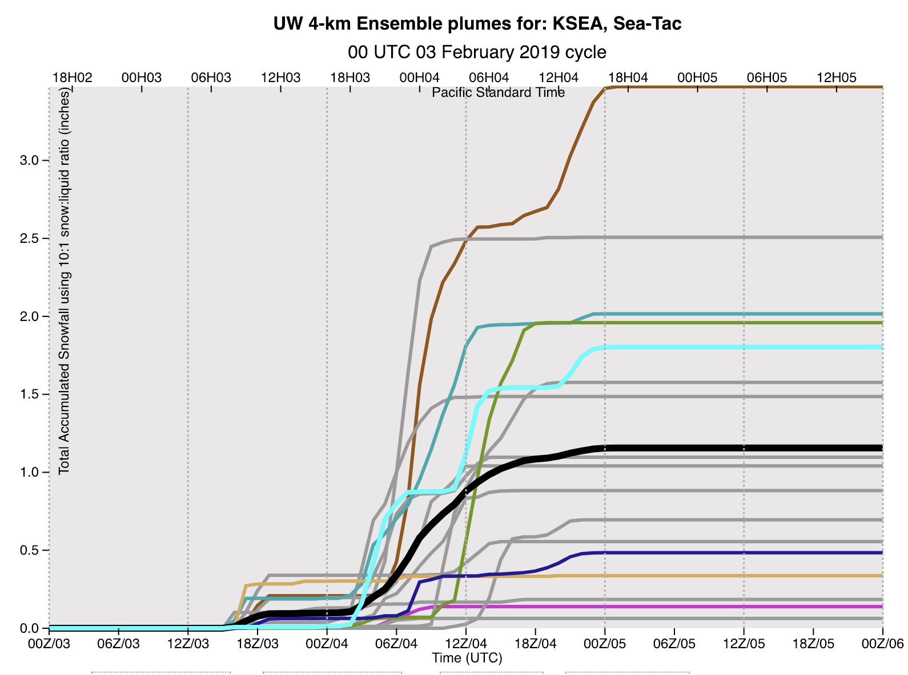
Why Better
Much better initialization and forecasts of incoming disturbances from the north
High resolution models with better physics
High resolution ensembles.

Slide 14
A Problem on the horizon: the new global model, FV-3
It was snow crazy last week.

Slide 15
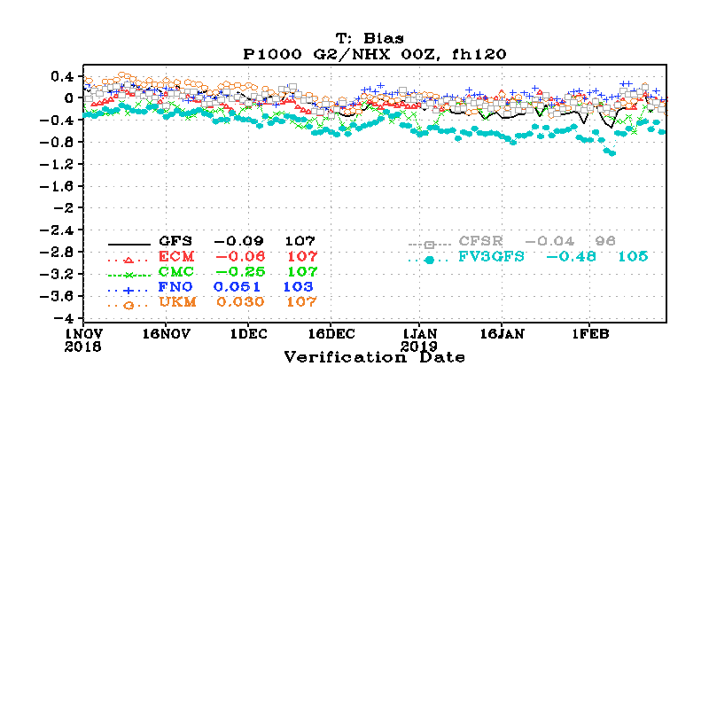
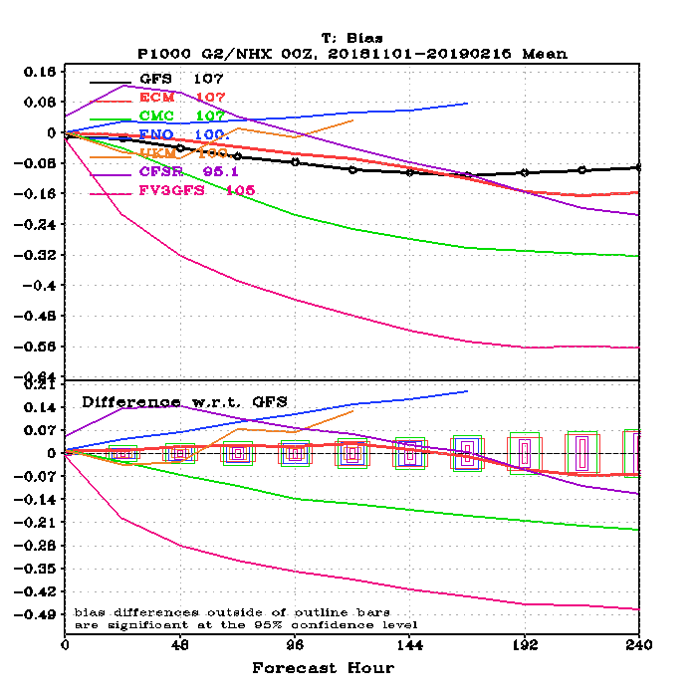

Slide 17
